Slide 1
MightyRides
20K-0209
20K-0292
20K-0151
20k-0300

Slide 2
Introduction
Car selling / purchasing platform
One-stop for all your car buying need!
Feedbacks
Friendly UI

Slide 3
Technologies & Tools
Front-end: HTML5, CSS 5, Bootstrap 5, JS ES6
Back-end: PHP
Database: MySQL using Xampp
IDE : VS Code

Slide 4
User View (Front END UI)
User Friendly UI & UX
Navigation through buttons allowing ease-of-access to various features
Search bar to find your desired car easily

Slide 5
Features
Register / Login
Add Car (Dealer)
Set Discount on a car (Dealer)
Buy / Rent Car (Buyer)
Check car details (customers)
Bought / Rented cars History
User Feedback (optional)
Explore listed cars

Slide 6
Customer End
Customer can search for a specific car
Customer can explore listed cars
Customer can view car details
Customer can see currently rented cars
Customer can see his purchase history
Customer can buy a car (Monetary Transaction not Implemented)

Slide 7
Dealer End
Dealer list a car
Dealer set discount
Dealer can delete a listed car
Dealer can view his sold count
Dealer can update his profile
When registering dealer can add branches

Slide 8

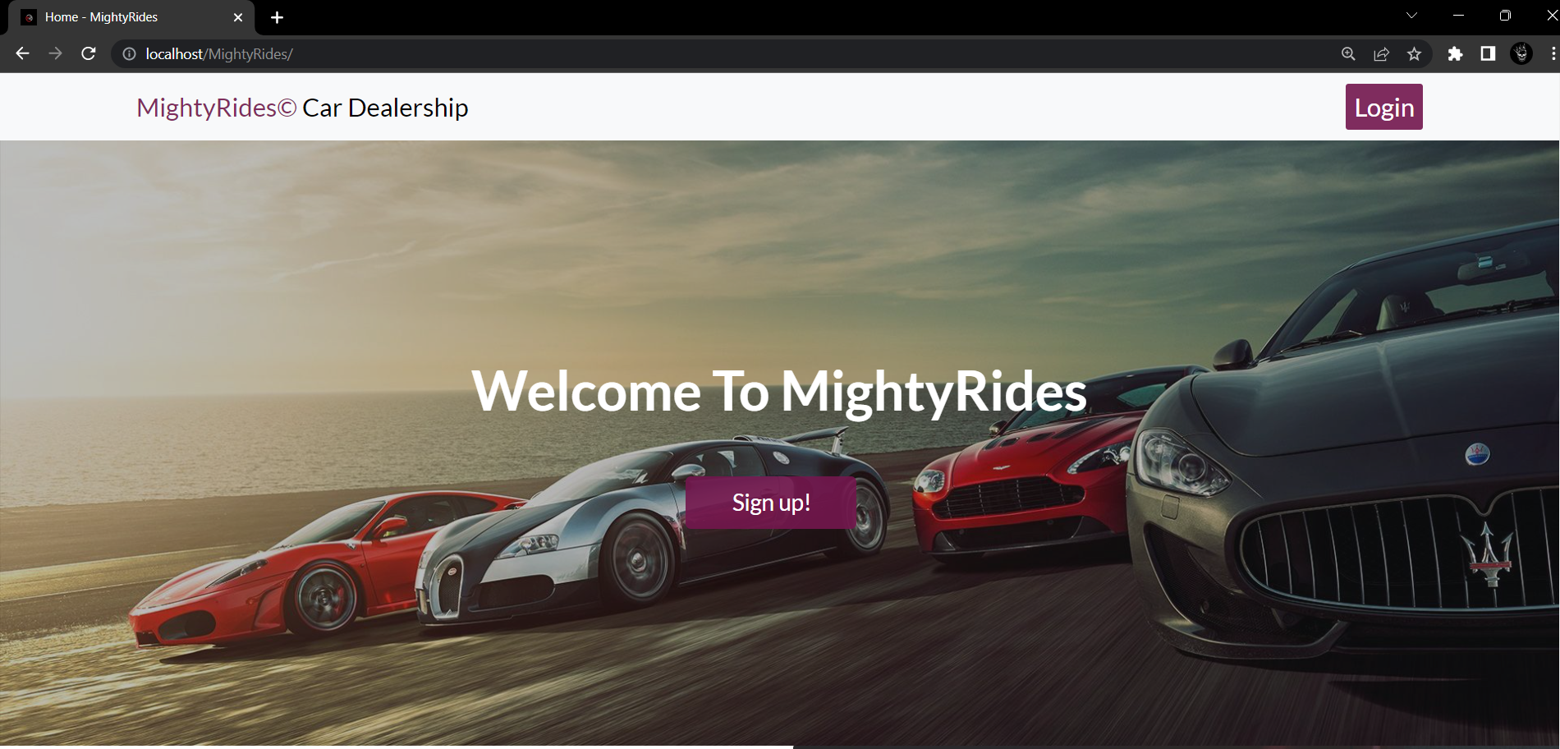

Slide 9
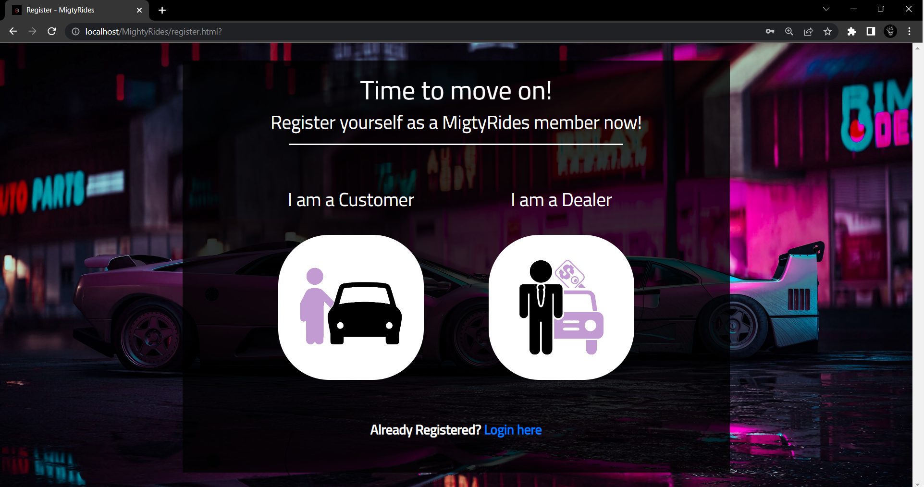

Slide 10
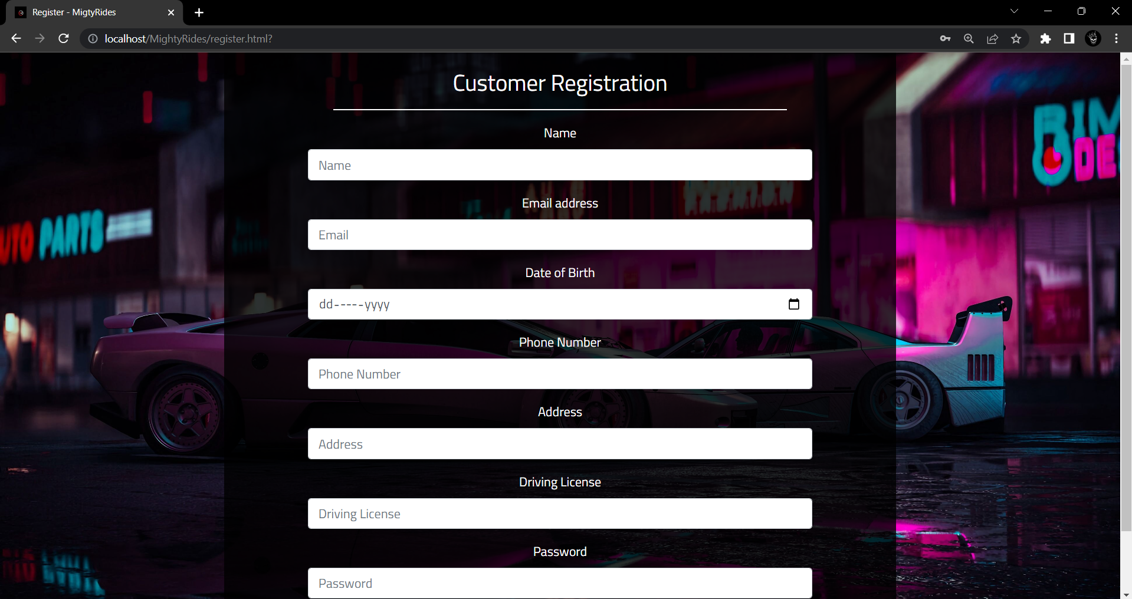

Slide 11
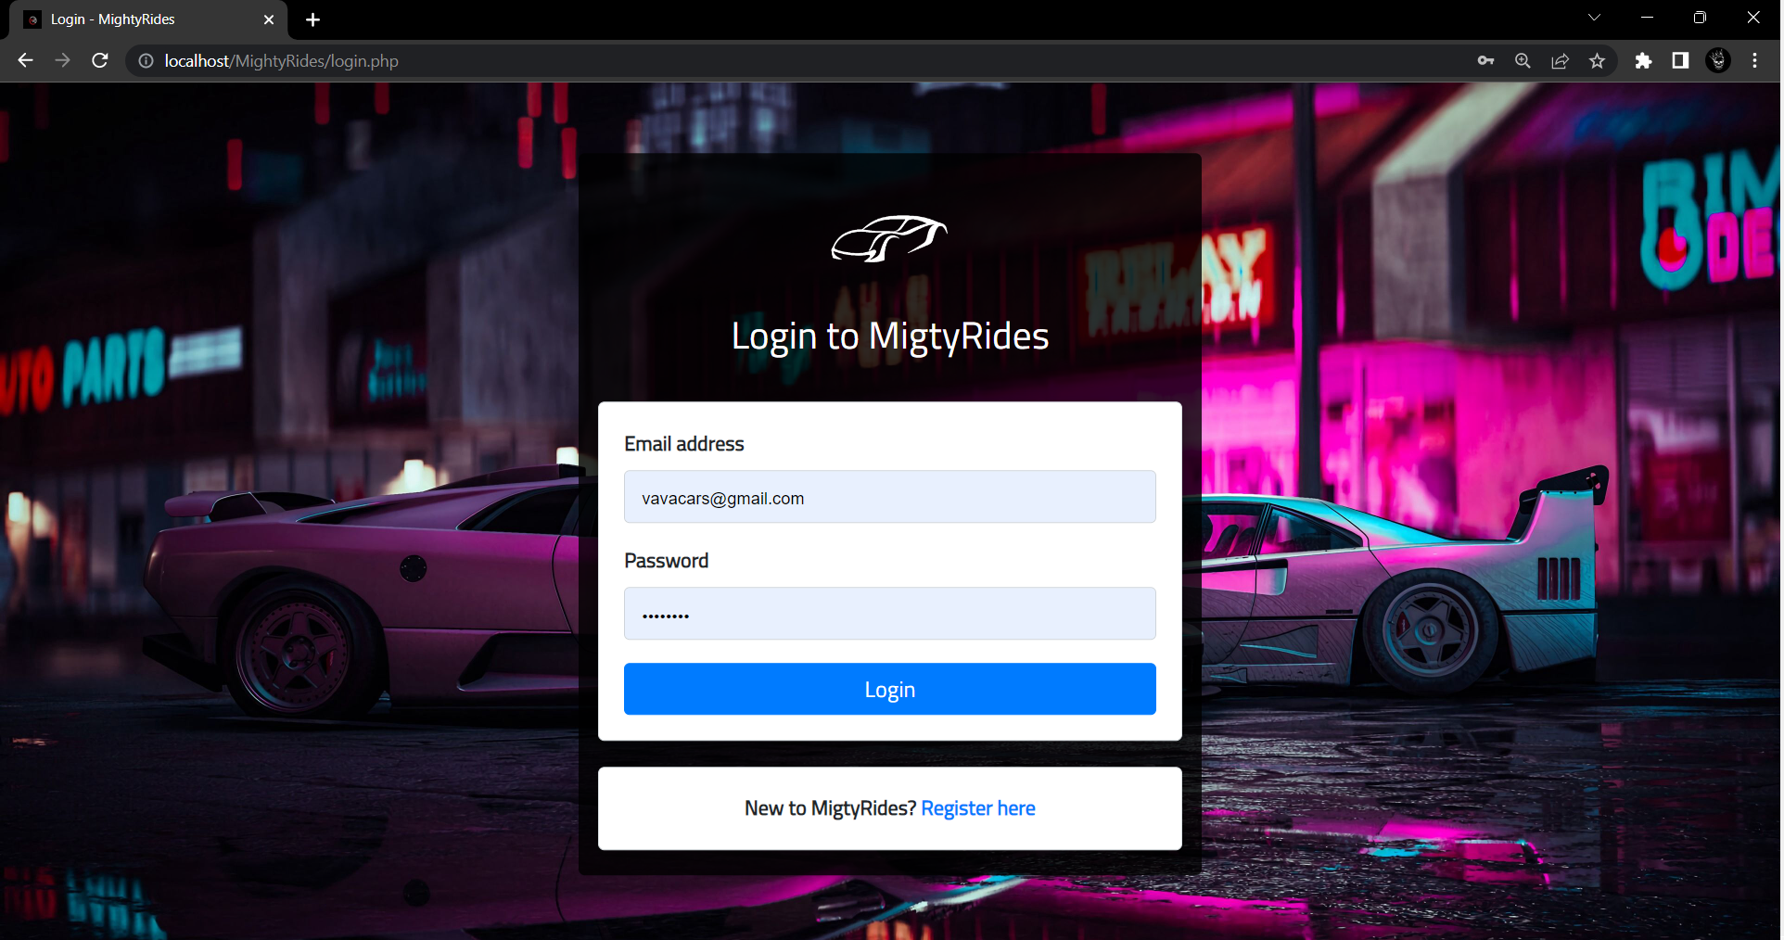

Slide 12
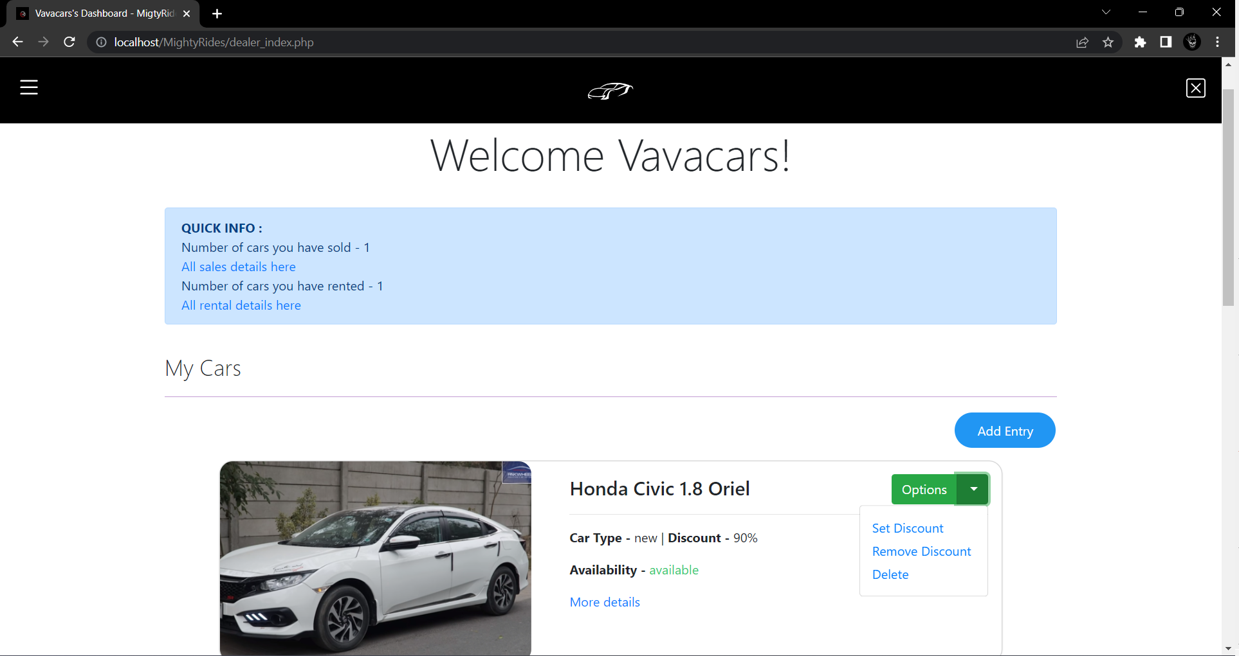

Slide 13
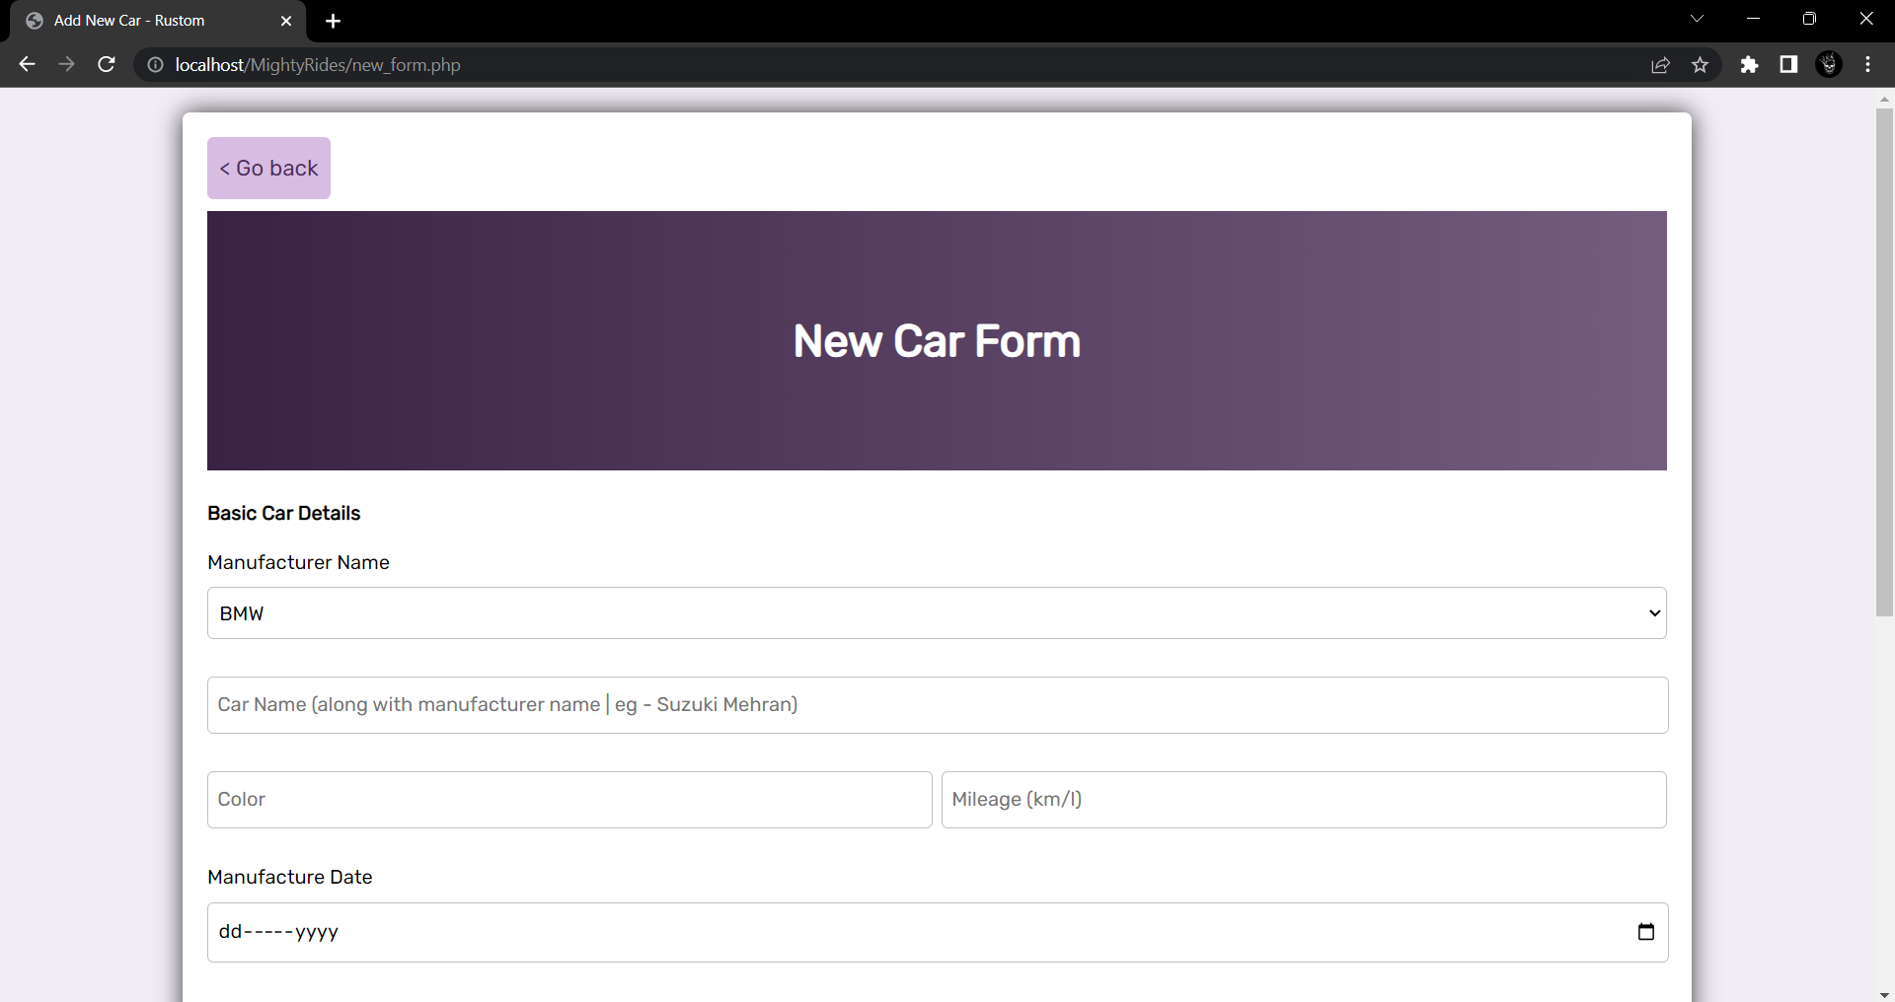

Slide 14
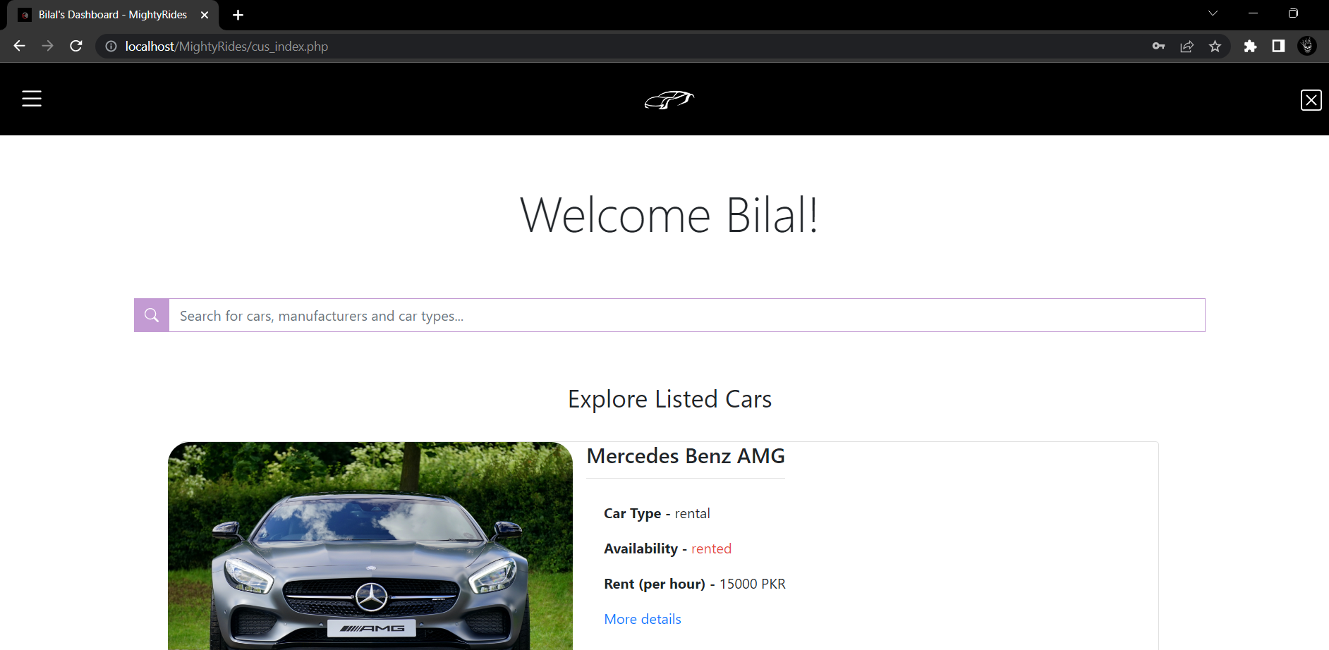

Slide 15
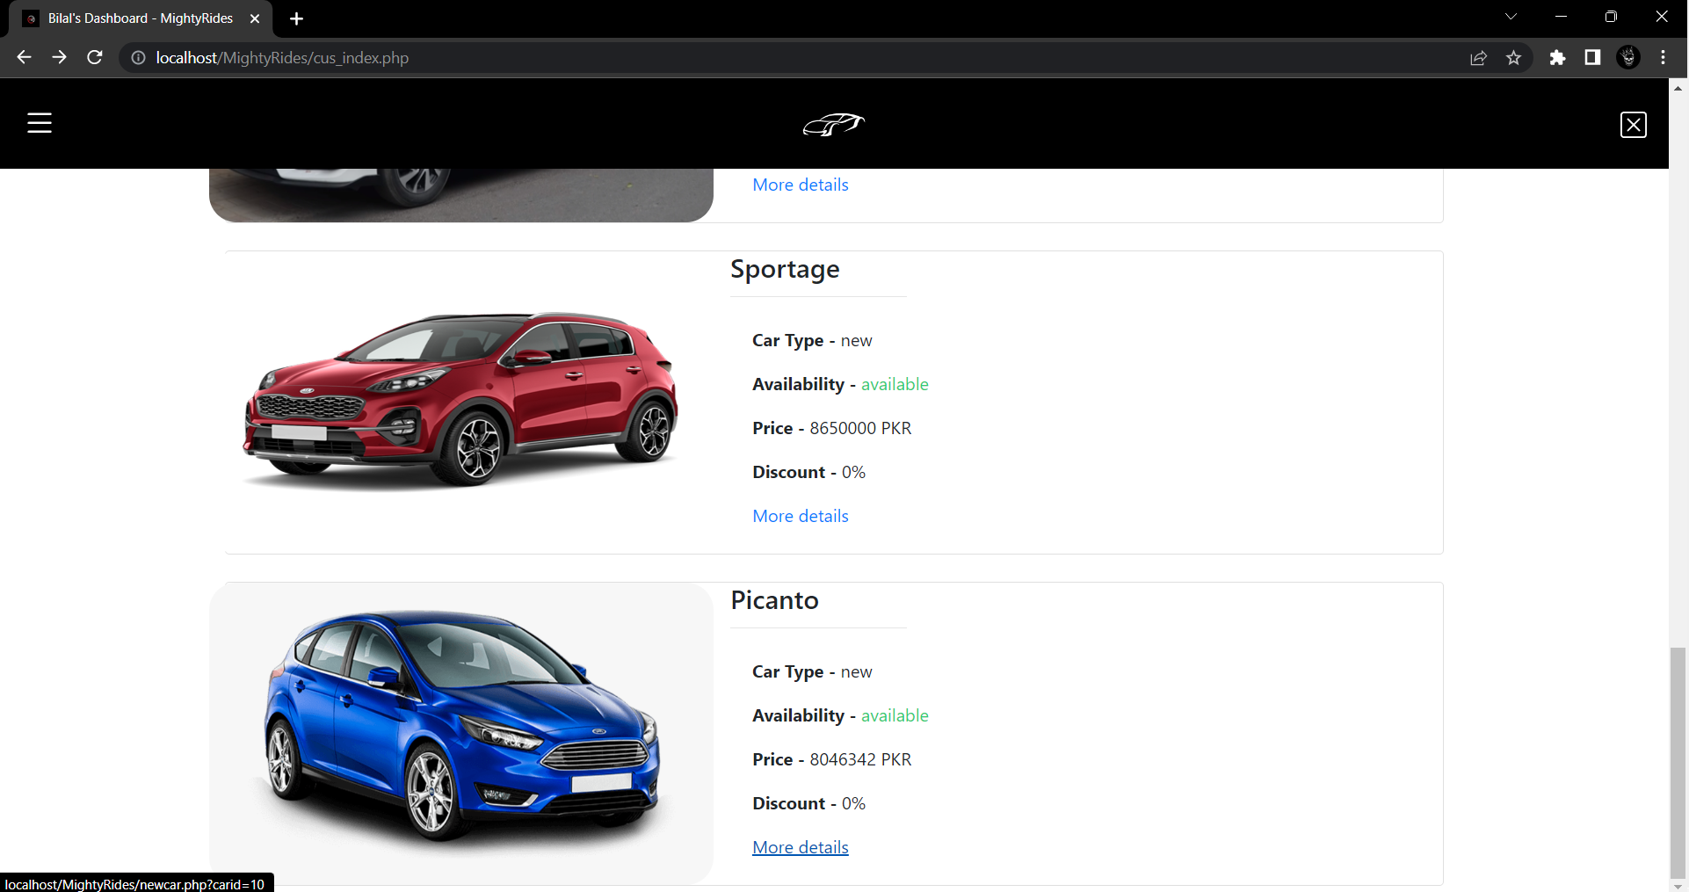

Slide 16
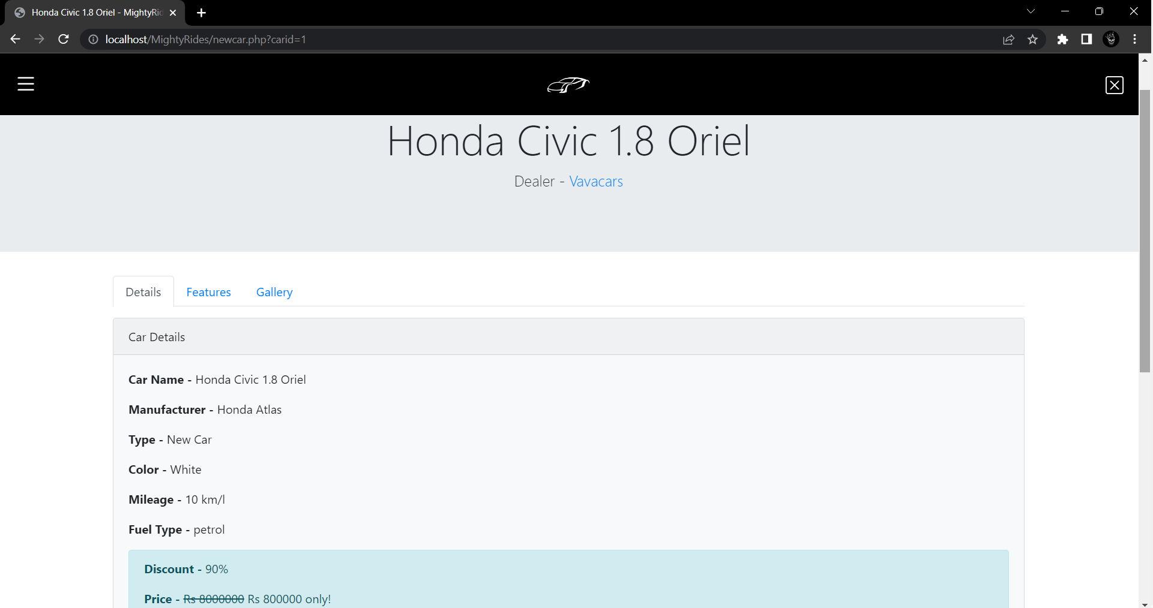

Slide 17
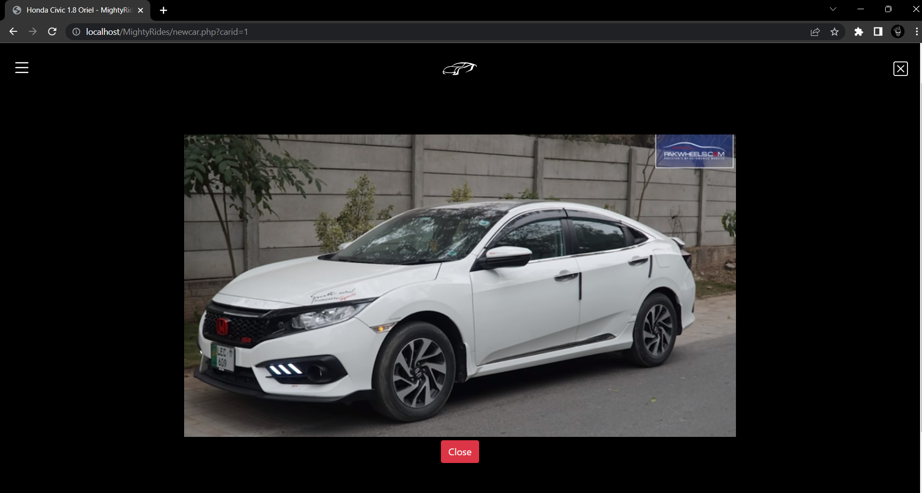

Slide 18
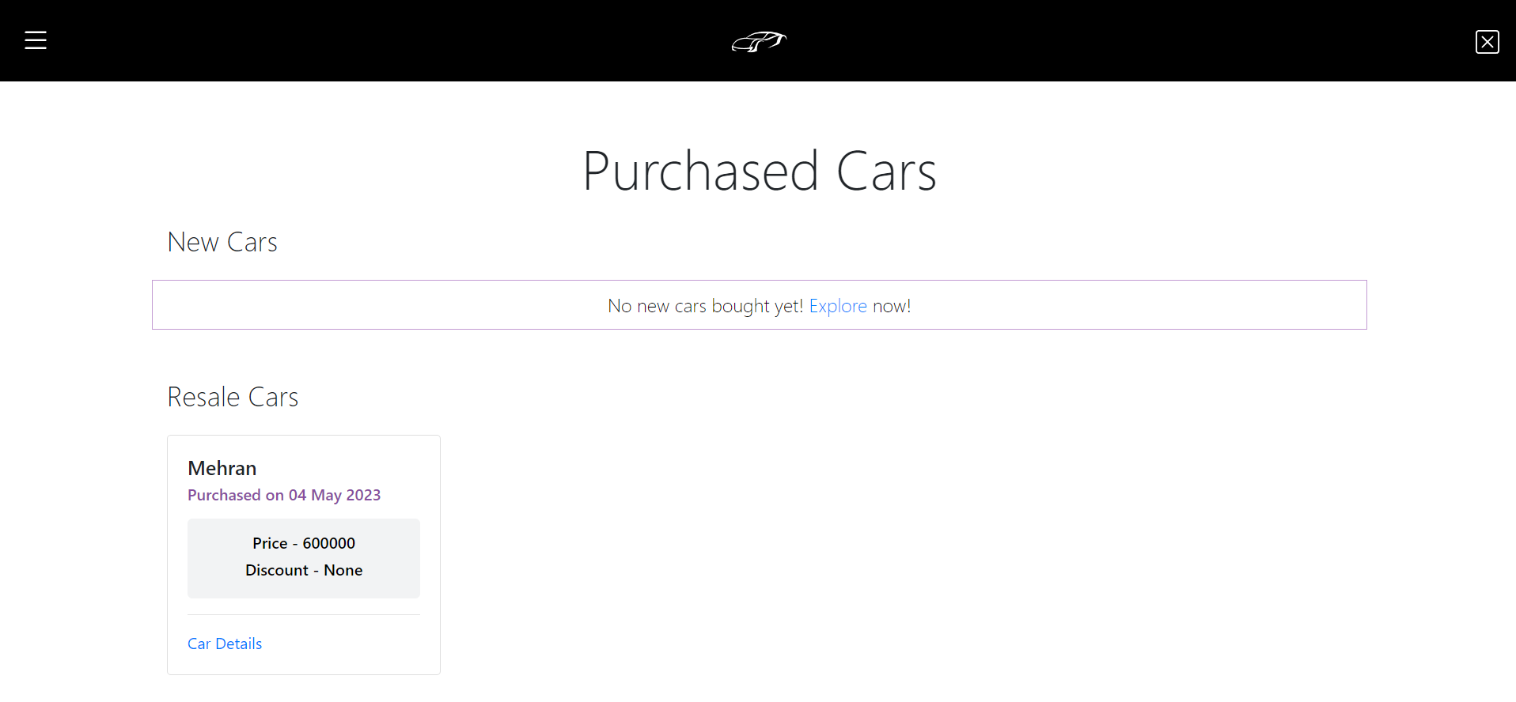
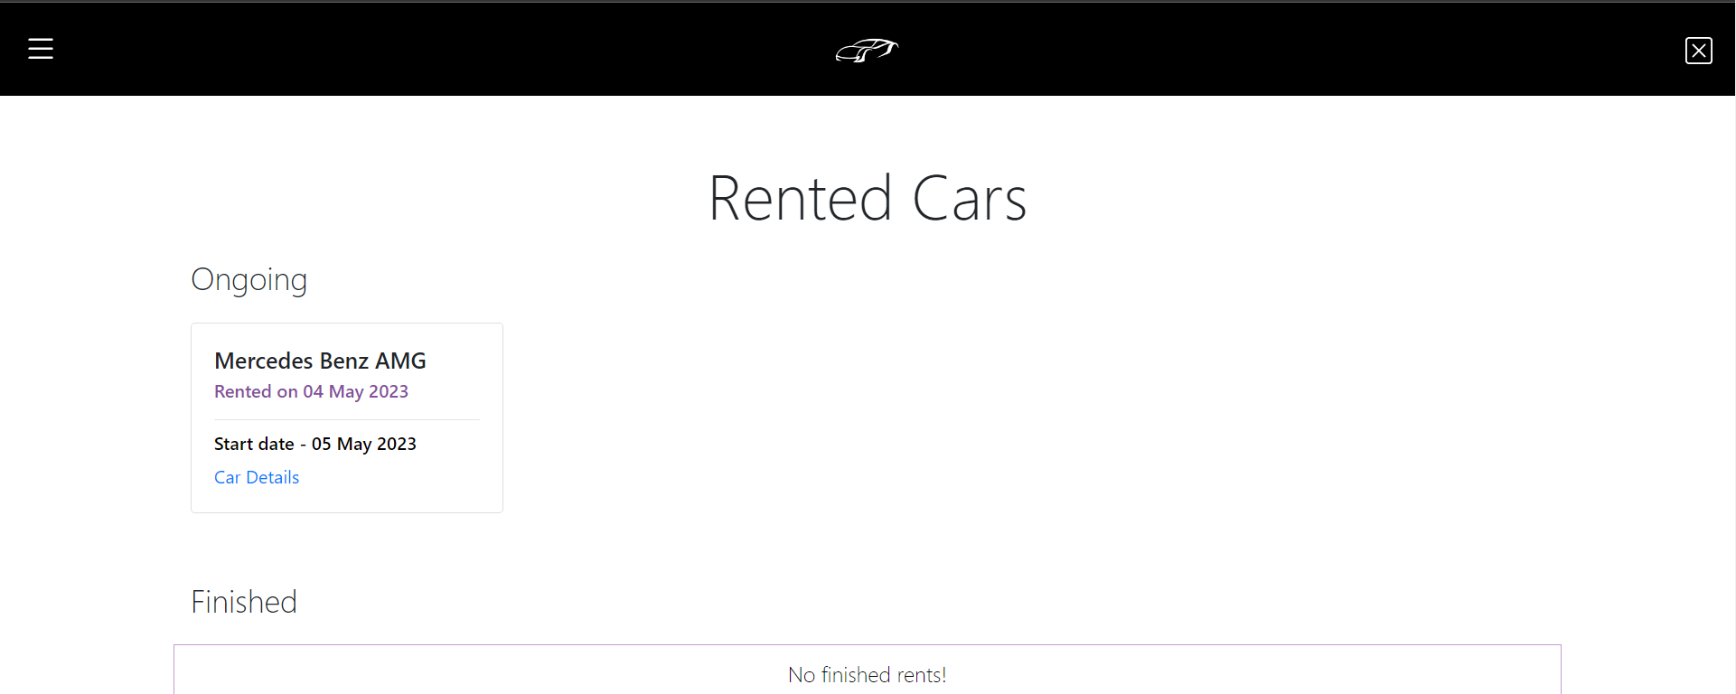

Slide 19
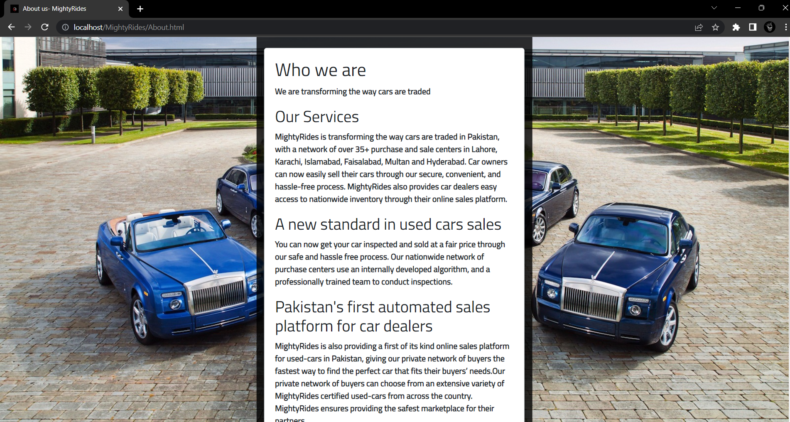

Slide 20
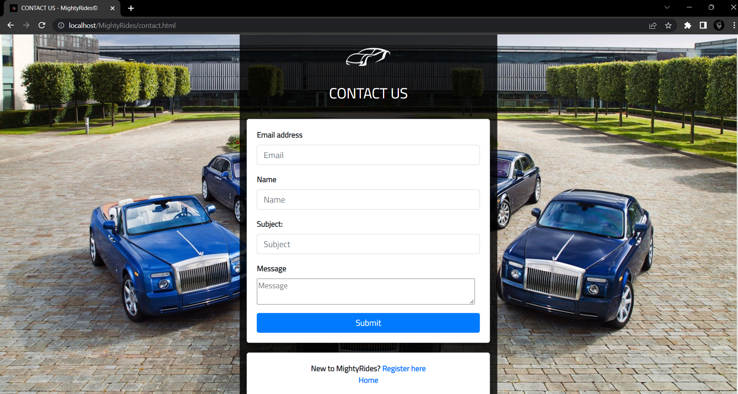

Slide 21
THE END

